Slide 1
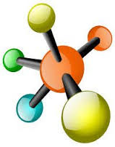


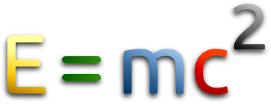

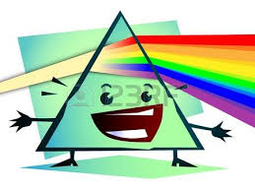

PHYSICAL QUANTITIES
GROUP WORK BY AQSA MOHSIN AND MUZAMMIL

Slide 2
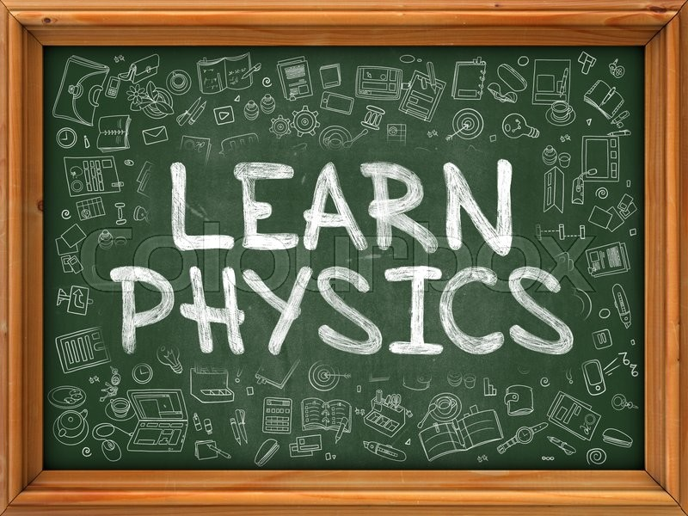
PHYSICAL QUANTIES
FUNDAMENTAL QUANTIES | SI unit | SYMBOL
LENGTH | Metre | m
MASS | Kilogram | Kg
TIME | Second | Sec
LUMINOUS INTENSITY | candela | cd
ELECTRIC CURRENT | Ampere | A
TEMERETURE | Kelvin | K
AMOUNT OF SUBSTANCE | mole | mol

Slide 3


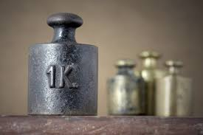
MASS;
”THE QUANTITY OF MATTER CONTAINED IN A A BODY IS CALLED ITS MASS”
SI UNIT
KILOGRAM:
” “THE MASS OF THE CYLINDER OF SPECIFIC DIMENSION MADE BY PLATINUM IRIDIUM ALLOY KEPT IN THE INTERNATIONAQL BUREAU OF WEIGHTS AND MEASUREAS IS TAKEN TO BE THE STANDARD 1 KG”

Slide 4
DIFFRENCE BETWEEN MASS AND WEIGHT
MASS | WEIGHT
The quantity of matter contained In a body | weight is the force with which earth attracts o body towards its centre
Mass is scaler quantity | weight is vector quantity `
SI unit of mass is kilogram(Kg) | SI unit of weight is newton(N)
Mass=force/acceleration | weight=mg
Mass is independent quantity | Weight is dependent quantity
DEFINATION
Physical nature
SI unit
expression
Dependent

Slide 5

Length;
In physics , length is an important quantity that is often used .
For example : we measure length to find out how far an object has moved , how much space an object occupies (i.e volume) and how far apart 2 objects are.
SI UNIT
METER
“1 Meter is the length of the path travelled my light I vacuum during a time interval of 1/299792458 of a second “

Slide 6

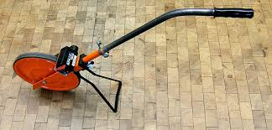
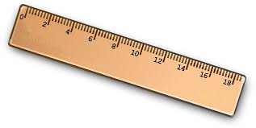
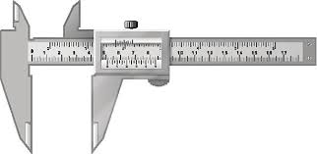
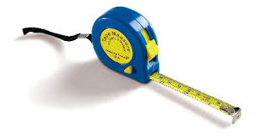
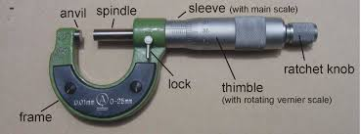
Measuring instruments of length
ruler
Trundle wheel
Vernier caliper
Screw gauge
Retractable tape

Slide 7

TIME:
“Time in physics is defined by its measurement : time is what a clock reads it is a scalar quantity and, like length, mass, and charge, is usually described as a fundamental quantity”.
SI UNIT
SECONDS;
“One second is 9192631770 periods of vibration of atoms of cesium-133”

Slide 8

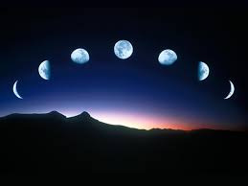
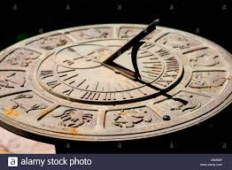
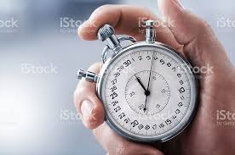

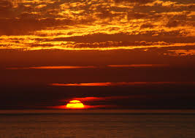
HOW TIME CAN BE MEASURE???
PHASES OF MOON
STOP WATCH
SUNDIL
SUNSETS
SEASONS

